Slide 1

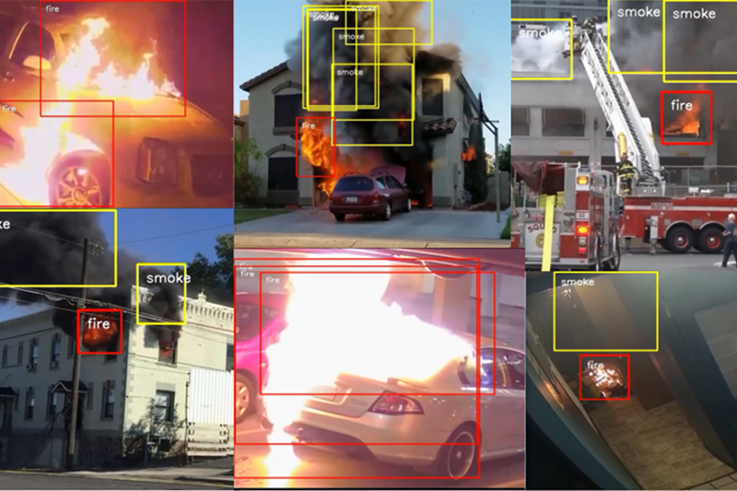
Enhancement of Fire and Smoke Detection by Using Image Based Techniques of CNN
Presented By :
D L Nandan Kumar
Suyash Naik
01

Slide 2
Table Of Content
1.Abstraction
2.Introduction
3.Importance of Detection
4.About Dataset
5.Methodology
5.Literature Review
6.Algorithm and Accuracy
6.Experimental Results
7.Visualisation of prediction
8.Conclusion
02

Slide 3
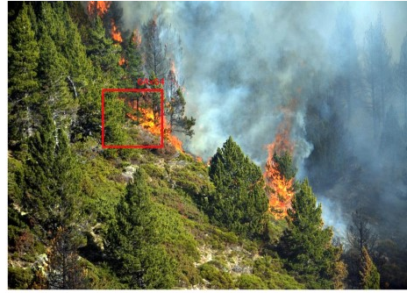
Abstraction
Detecting fire and smoke in visual scenes is challenging due to variations in color and texture. This study proposes a deep convolutional neural network (CNN) with adaptive piecewise linear units for improved accuracy. A custom fire and smoke image dataset was developed, with data augmentation and generative adversarial networks (GANs) used to prevent overfitting. Experimental results highlight the model's high accuracy and effectiveness, offering a robust solution for fire and smoke detection.
03

Slide 4
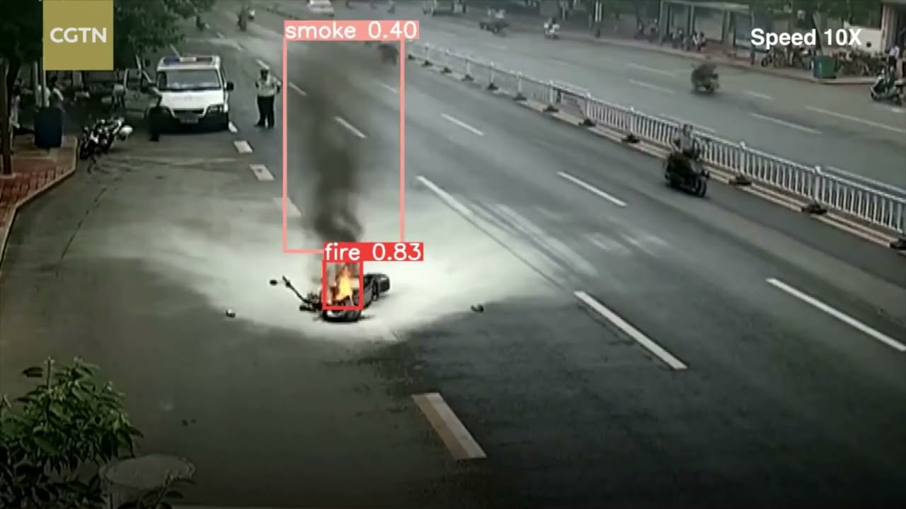
Introduction to Fire and Smoke Detection
Fire incidents pose critical threats to life, property, and the environment. Traditional detection methods often fail due to false alarms and limited coverage. CNN-based image detection systems provide real-time alerts, extensive area monitoring, and IoT integration, ensuring faster, more accurate responses. These systems are transformative for smart cities, improving public safety despite challenges like computational demands.
01
04

Slide 5
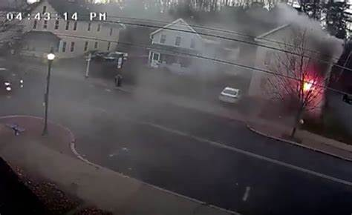
Why is Detection Important?
It ensures rapid response to fire hazards, minimizing risks to life, property, and the environment. Early detection helps prevent disasters, enhances public safety, and supports smart city initiatives through real-time monitoring and alerts.
05

Slide 6
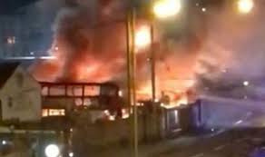
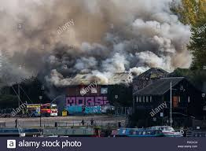

About Datasets
The dataset consists of Fire, Smoke, and Neutral images
Total Images: 5,000
Fire: 2,000 images
Smoke: 1,500 images
Neutral: 1,500 images
01
06

Slide 7
Methodology
Step 1: Data Preprocessing - Resize images, augment, and normalize using PyTorch transforms.
Step 2: Model Selection - Utilize ResNet50 with pre-trained weights for transfer learning.
Step 3: Training - Fine-tune the model using labeled data and CrossEntropyLoss.
Step 4: Validation - Evaluate using metrics like accuracy and loss.
Step 5: Deployment - Deploy the trained model for real-time prediction in images and videos.
Data Collection → Preprocessing → Model Training → Evaluation → Deployment.
07

Slide 8
Literature Review
Authors | Research Titles |  | Findings
Mask R-CNN (2022) | Fire and Smoke Object Detection Using Mask R-CNN |  | Utilized computer vision technology to detect fire and smoke in forest fire scenarios, overcoming limitations like visual range constraints and errors..
Xiong et al. | Turbulent Characteristics of Smoke and Flames. |  | Identified complexities in distinguishing smoke and flames from non-fire objects using dimensionless measures like edge/area or surface/volume ratios.
Bheemul & Jian | Feature Extraction Methods for Fire and Smoke Detection |  | Focused on edge detection techniques (e.g., Canny detector) to analyze geometrical and brightness changes for flame and smoke identification.
AlexNet Study (2023)) | Advancing Reliable Fire Detection Systems Using AlexNet |  | Demonstrated superior classification of fire and smoke images under diverse conditions, emphasizing the importance of curated datasets for robust systems.
General Review | Evolving Fire Detection Systems ThroughCamera-Based Techniques. |  | Highlighted advancements in monitoring larger areas for early detection, addressing traditional limitations in open spaces or delayed smoke detection.
08

Slide 9
Algorithm and Accuracy
Framework: PyTorch-based Convolutional Neural Network (CNN).
Training Details:
Optimizer: Adam for efficient parameter updates.
Loss Function: CrossEntropyLoss for multi-class classification.
Epochs: Trained over 10 epochs to balance accuracy and computational efficiency.
Performance:
Training Accuracy: ~95%.
Validation Accuracy: ~92%.
Key Features:
Effectively detects fire and smoke under diverse and challenging conditions.
Robust against variations in smoke density, flame color, and environmental factors.
Suitable for applications in forest fire prevention, urban safety systems, and industrial monitoring.
09

Slide 10
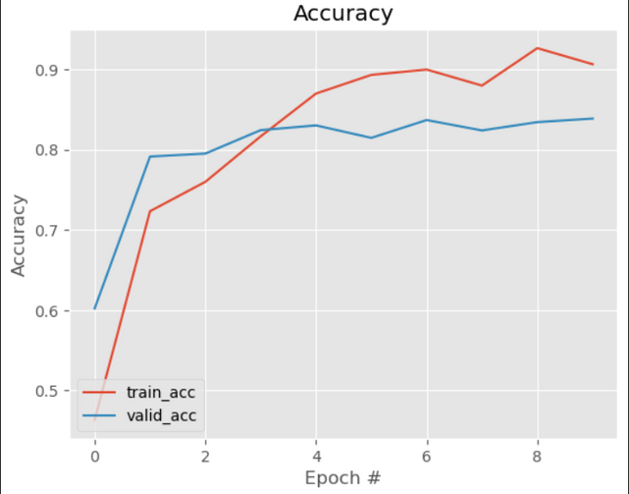
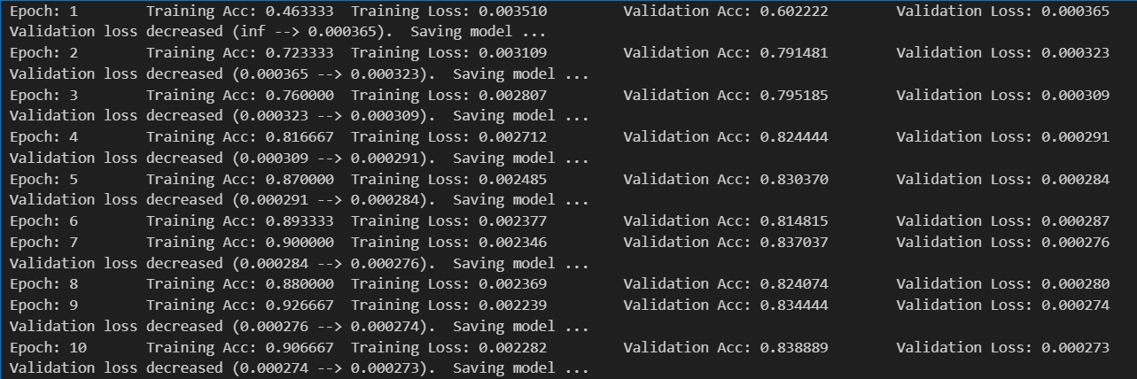
Experimental Results
The graph illustrates the accuracy improvement for training and validation data across epochs
The model was trained for 10 epochs, achieving consistent improvements in validation accuracy and loss reduction.
10

Slide 11
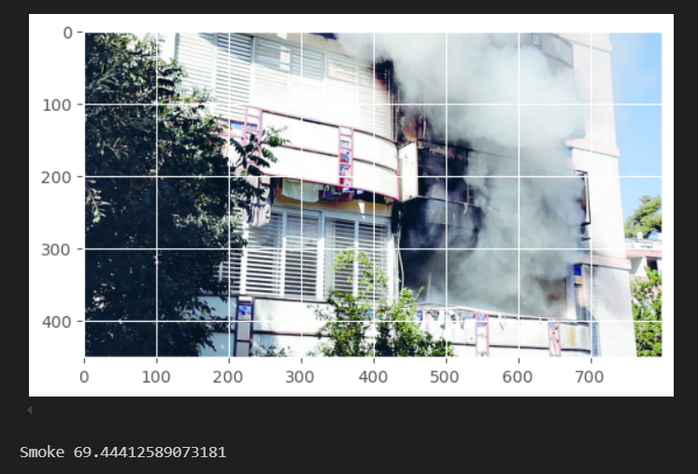
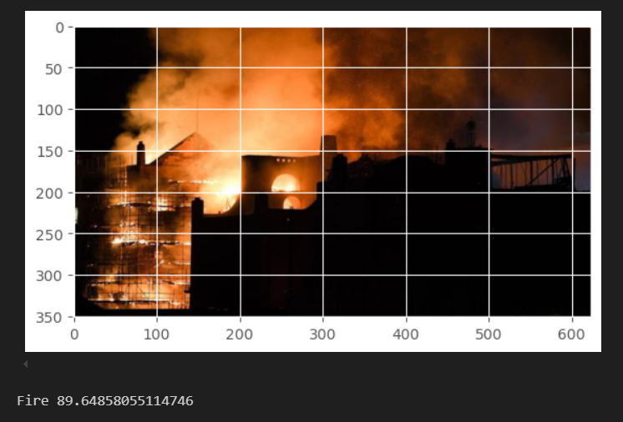
Visualization of Predictions
• Static Images: Predicted class with confidence scores.
• Image Frames: Real-time classification results visualized.
•Example: Fire detected with a confidence of 98%.
11

Slide 12
Future Works
Improve dataset quality and diversity (e.g., include various lighting conditions).
Develop a video-based real-time detection system.
Optimize the model for deployment on edge devices.
Integrate with IoT systems for smart monitoring and alerting.
12

Slide 13
Conclusion
Model Achievements: Successfully trained for fire and smoke detection with real-time inference capability.
Practical Applications: Suitable for wildfire monitoring, industrial safety, and urban surveillance.
Future Scope:
Enhance dataset diversity for better generalization.
Optimize model accuracy and efficiency.
Explore integration of multimodal data (e.g., thermal sensors).
Impact: Contributes to disaster prevention, public safety, and sustainability.
13

Slide 14
Thank You
14

